Slide 1

Cam Refinance
Group 6
Presented by KOH Tito

Slide 2
Our team
1. KOH TITO
2. LAY Chhay
3. DORN Dawin
4. LAB Thavrith
5. HUN Sokrarith

Slide 3
Agenda
01. Introduction
02. Objective
Why do we make this project?
What is our goal?.
03. Identify tasks
04. Scope of the project
05. Group schedule
What are the tasks or challenges that we are going to encounter?
Things needed to be done to achieve our goal.
Our plan to complete this project successfully and peacefully.

Slide 4

1. Introduction
What is Refinance?
Why do we need to think about it?
Refinance is finance (something) again, typically with new loans at a lower rate of interest.
We can take some advantage from it such as better interest rate and free up cash.

Slide 5
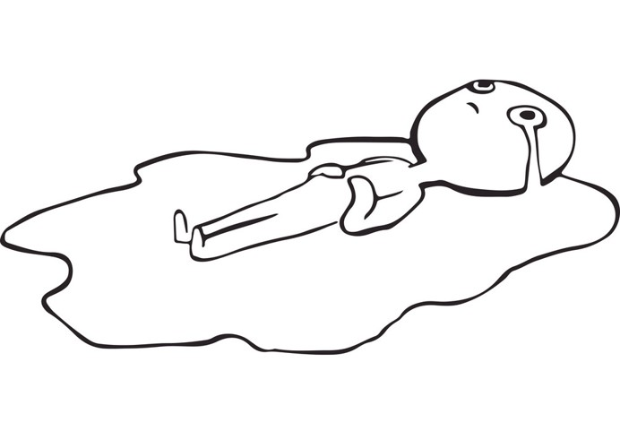
2. Objective
What is the goal of this project?
By the name of TDCR2 Financial Group, we are excited to inform all of you who are planning to buy a house to know that our group are creating a website in order to:
• Help to take lower monthly mortgage payment by secure a new mortgage with low interest rate.
• Track on your monthly payment
• Give you a recommendation on the next defined banks
• Get a house faster with less money spent as much as possible.
High debt
Long term
What’s next?

Slide 6

3. Identify tasks

Slide 7
Task management
KOH Tito
DORN Dawin & HUN Sokrarith
• Data scraping (house sale online)
• Creating UI design for the website
• Creating website (front-end, back-end and Database)
• Gathering data (Banks)
• Creating website(frond-end)
LAY Chhay
LAB Thavrith
• Managing data (Banks)
• Creating website(front-end)
• Data scraping (house sale online)
• Creating website(front-end)
.

Slide 8
4. Scope of the project
To do:
Tools:
For data scraping
For bank’s information
For design website
For creating website
For storing and sharing code or some documents
For IDE
Python, BeautifulSoup…etc.
We are going to discuss with professional staff and some information from the feedback on social media.
Figma
HTML, CSS, JavaScript for front-end, node.js for back-end and SQL for database.
Github
Jupyter Notebook, vscode...etc.

Slide 9

Step-by-step
For the step by step:
• We are going to discuss on how our company work in order to help user.
• Gathering all data from house sale online, bank’s information and some others term.
• Designing website on Figma.
• Creating website.

Slide 10
5. Schedule
We are planning to finish this project in mid January, on 14th week of the semester.
We start our meeting twice for every week to check the progress and discuss more on how to develop this website.
We have started this project from mid November, on 5th week of the semester.

Slide 11


Thank you

